Slide 1
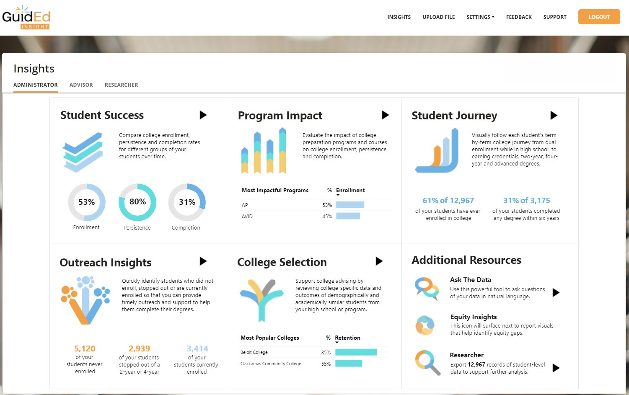
Degrees of Change - Guided Insights
Engagement Overview
Degrees of Change, a nonprofit organization, needed to replace a legacy portal used to analyze student enrollment and degree data. The outdated system was slow, difficult to use, and limited access to timely insights. They wanted a modern, secure platform that would enable educators and administrators to quickly turn student data into actionable insights.
What We Did
Built a modern SaaS analytics portal with a clean, intuitive user experience
Designed a scalable data processing architecture to support high concurrency
Implemented secure data isolation with separate repositories per customer
Embedded Power BI dashboards for a unified analytics experience
Enabled optional single sign-on using Clever.
Results
Reduced insight delivery from hours to near real-time
Enabled self-service access and transparency for student data uploads
Delivered a scalable, cost-efficient cloud platform
Automated onboarding and offboarding through dynamic resource provisioning.

Slide 2
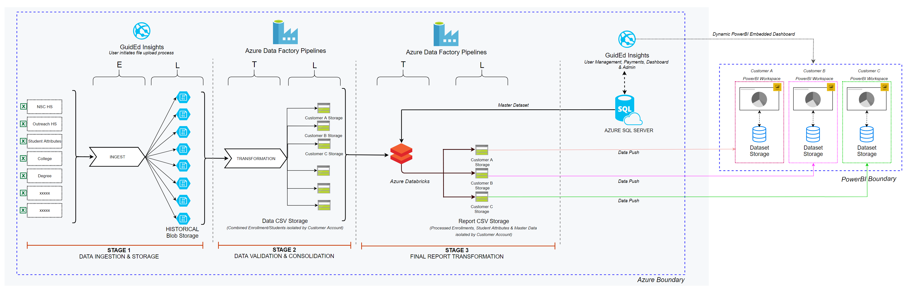
Technical Architecture: Guided Insight

